Slide 1
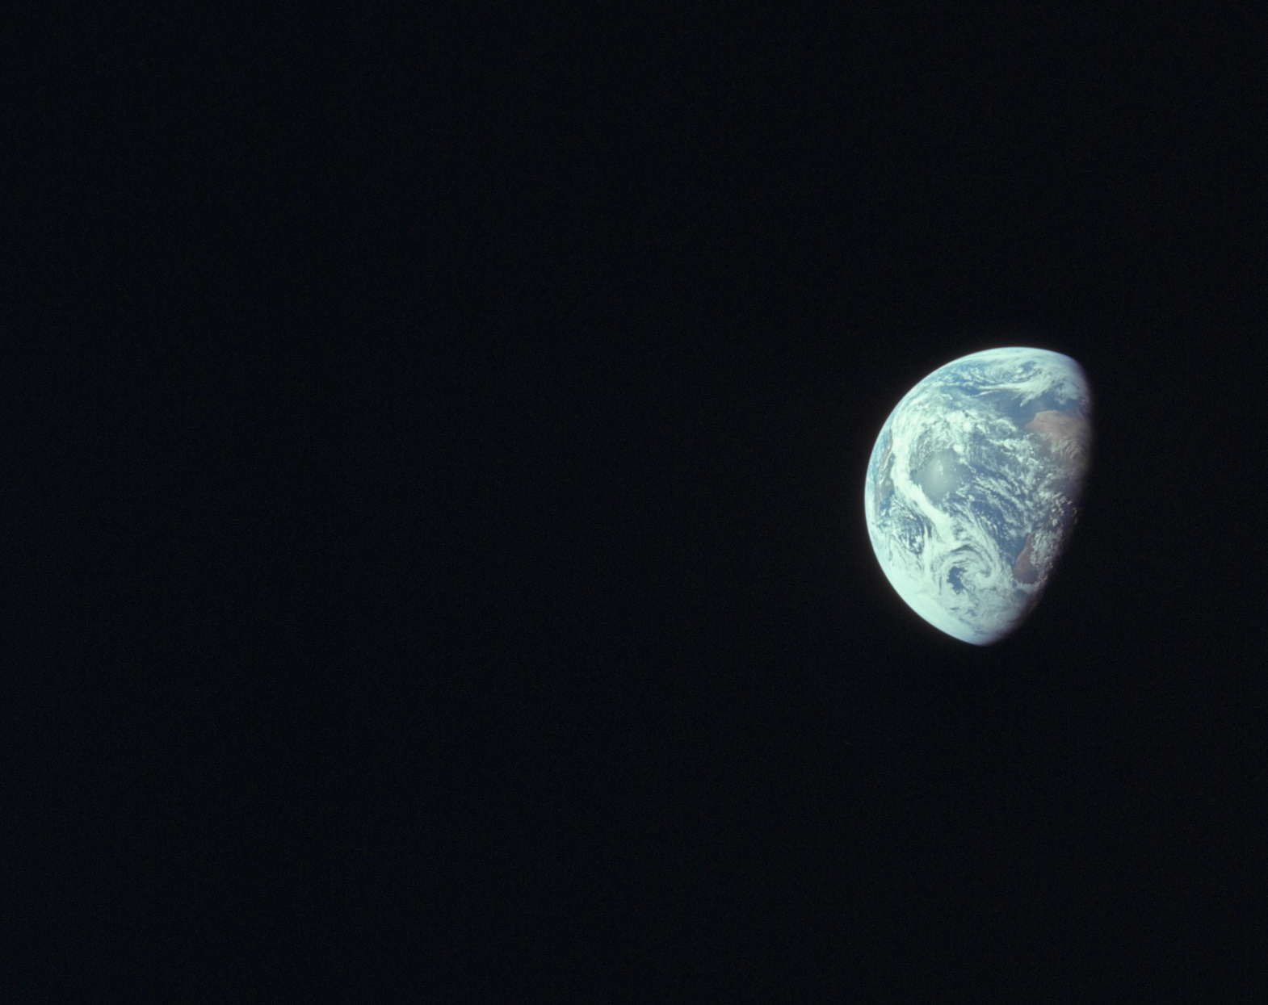




A Potential Mechanism for Nitrogen Storage in the Earth’s Mantle Transition Zone
Shradha Ravikumar¹, S.-H. Dan Shim¹
¹Arizona State University, School of Earth and Space Exploration
Arizona NASA Space Grant Statewide Research Symposium
Tempe, AZ
April 22, 2023
Image Source: https://www.visibleearth.nasa.gov/images/144427/all-of-you-on-the-good-earth/144427f

Slide 2
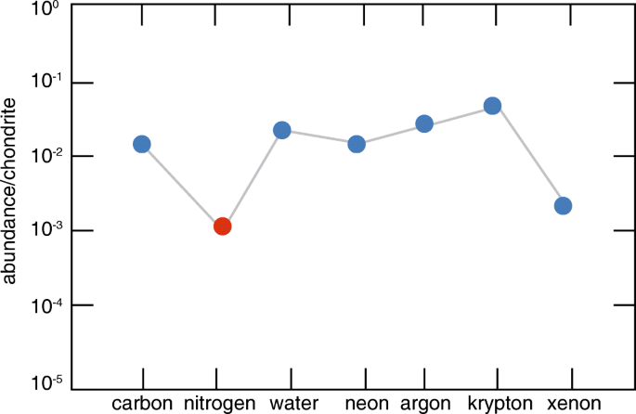
Earth’s “missing nitrogen” problem
N is depleted in the bulk silicate Earth.
Source: Mysen 2019; modified from Marty 2012

Slide 3
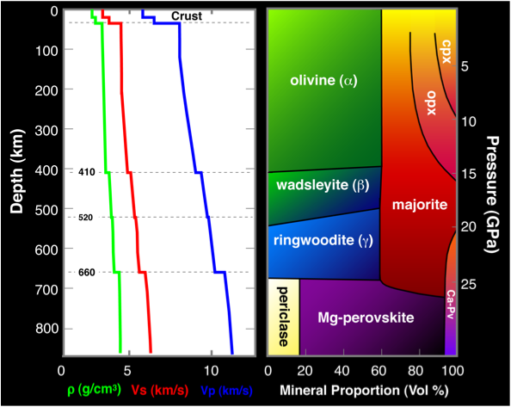
Source: modified from Schmerr 2012
N in ringwoodite: 104.5 ± 19.6 μg/g (1600 °C, 21 GPa; Yoshioka et al. 2018)
Incorporation mechanism unknown
MTZ

Slide 4
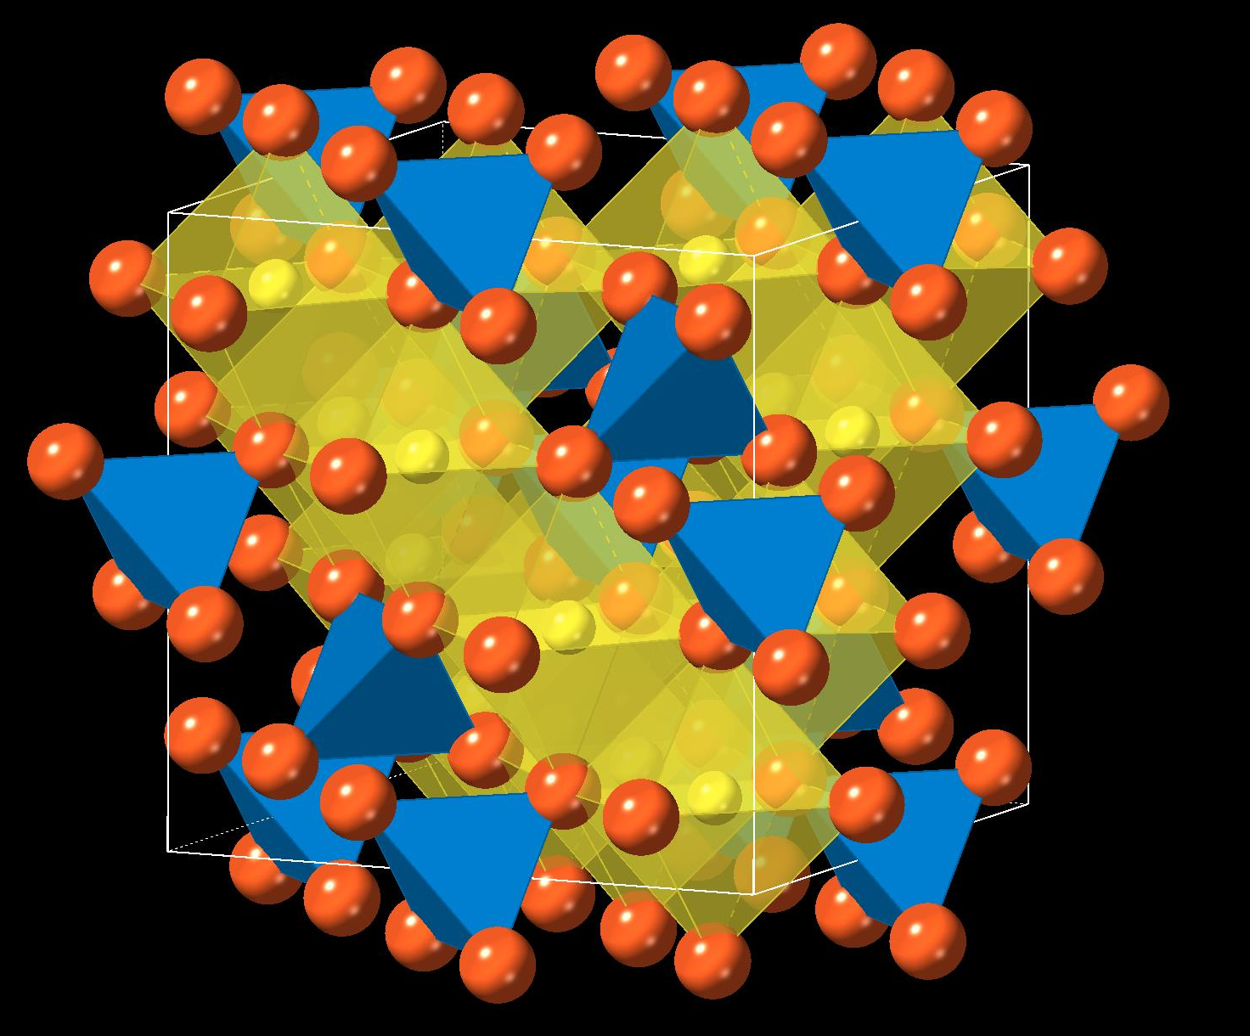
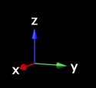
Solid solution between ringwoodite (Mg₂SiO₄) and silicon nitride (Si₃N₄)
Charge-coupled substitution
Cation site (A)
Site A
Cation site (B)
Mg²⁺ + 2O²⁻ = Si⁴⁺ + 2N³⁻
Anion site
Anion sites
Generic cubic spinel structure

Slide 5
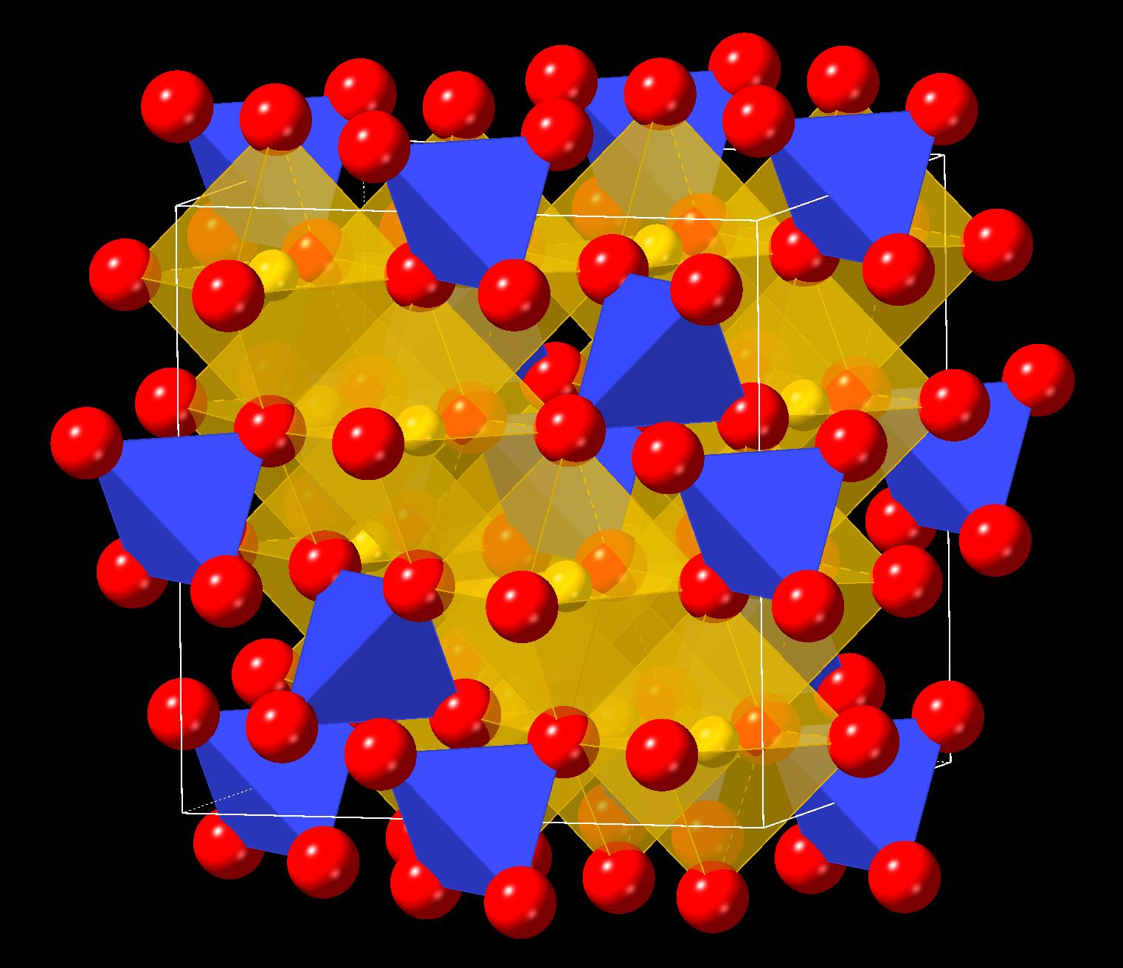

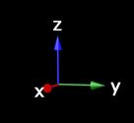
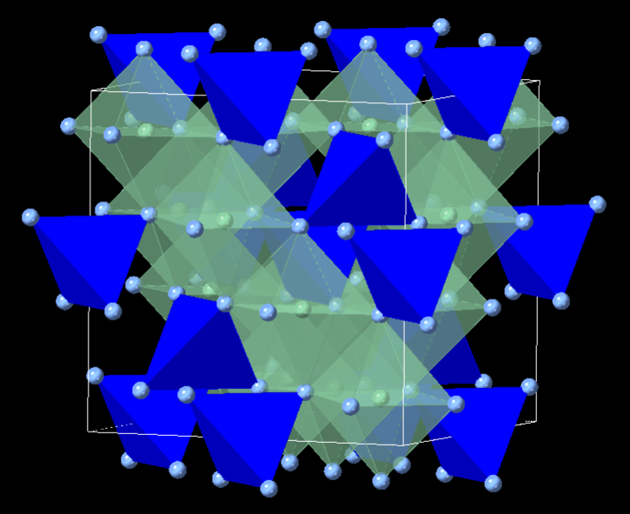
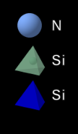
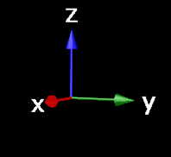
End-Member Data: Density-Functional Theory Calculations
Ringwoodite
(Mg₂SiO₄)
Internal energy (U)
Volume (V)
0-25 GPa (5 GPa intervals)
  k-points: 8, 8, 8
  Encut value: 800
  XC functionals: LDA and GGA
Silicon Nitride (Si₃N₄)

Slide 6
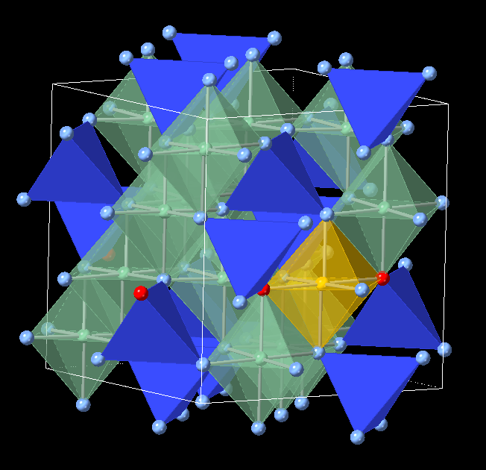
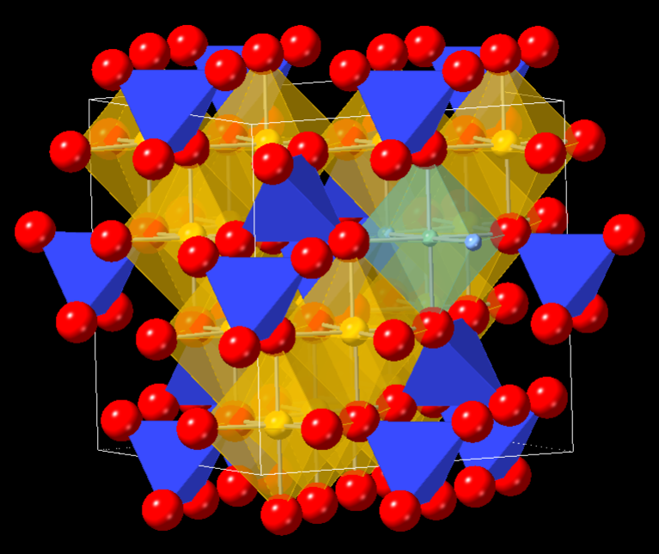
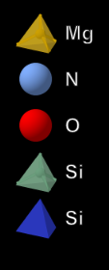
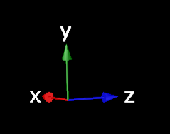
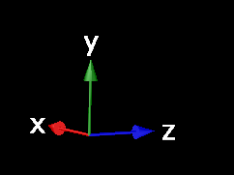
Solid Solution Data
93.75 mol% Si₃N₄
6.25 mol% Si₃N₄
Other tested compositions:
25 mol%, 50 mol% Si₃N₄, 75 mol% Si₃N₄

Slide 7
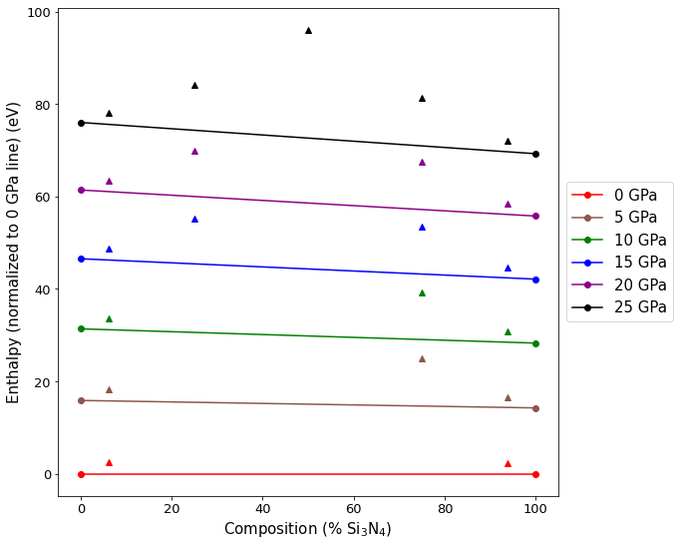
Assessing Stability (XC Functional: LDA)
Internal energy
Pressure
H = U + PV
Enthalpy
Unit cell volume

Slide 8
Assessing Stability (XC Functional: LDA)
Composition (mol % Si₃N₄) | Average Energy Difference (eV)
6.25 | 2.437 ± 0.002
25 | 9.820 ± 0.012
50 | 23.45
75 | 10.31 ± 0.02
93.75 | 2.270 ± 0.014

Slide 9
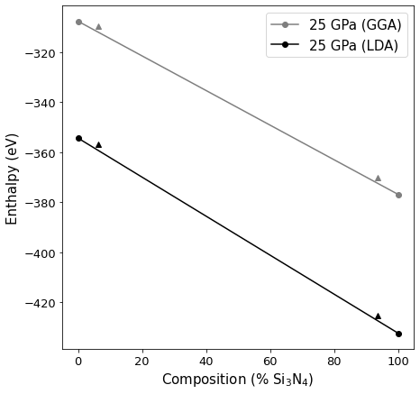
Assessing Stability (XC Functional: GGA)
XC Functional | Composition (mol % Si₃N₄) | 25 GPa Energy Diff. (eV)
LDA | 6.25 | 2.441
 | 93.75 | 2.290
GGA | 6.25 | 2.509
GGA | 93.75 | 2.335

Slide 10
Preliminary Conclusions
DFT calculations indicate that charge-coupled substitution between ringwoodite (Mg₂SiO₄) and silicon nitride (Si₃N₄) is not thermodynamically favorable at 0 K.
  MTZ temperature: ~1870 K-2470 K (Zhou et al. 2022)
  High temperature may stabilize this solid solution.
Future Work
Multi-anvil cell experiments (high P/T conditions)
Assess stability of other substitution mechanisms
  NH₄⁺ in cation site?
  N⁻³ substituting for O⁻² with vacancies?

Slide 11
Acknowledgements
Dr. Dan Shim
Members of the Dan Shim Lab (Taehyun Kim, Xuehui Wei, Sibo Chen)
Dr. Thomas Sharp and Dr. Richard Hervig
ASU Core Facilities (Agave Supercluster)
Funding provided by:
ASU/NASA Space Grant Program
National Science Foundation

Slide 12
Thank You!

Slide 13
References
Marty, B. The origins and concentrations of water, carbon, nitrogen and noble gases on Earth. Earth and Planetary Science Letters 313–314, 56–66 (2012).
Mysen, B. Nitrogen in the Earth: abundance and transport. Progress in Earth and Planetary Science 6, 38 (2019).
Schmerr, N.C. (2012). Upper Mantle Discontinuities. https://www.geol.umd.edu/~nschmerr/research/upper-mantle-discontinuity.html
Yoshioka, T., Wiedenbeck, M., Shcheka, S. & Keppler, H. Nitrogen solubility in the deep mantle and the origin of Earth’s primordial nitrogen budget. Earth and Planetary Science Letters 488, 134–143 (2018).
Zhou, W.-Y. et al. Constraining composition and temperature variations in the mantle transition zone. Nat Commun 13, 1094 (2022).

